Slide 1

SEVENTISE

Slide 2
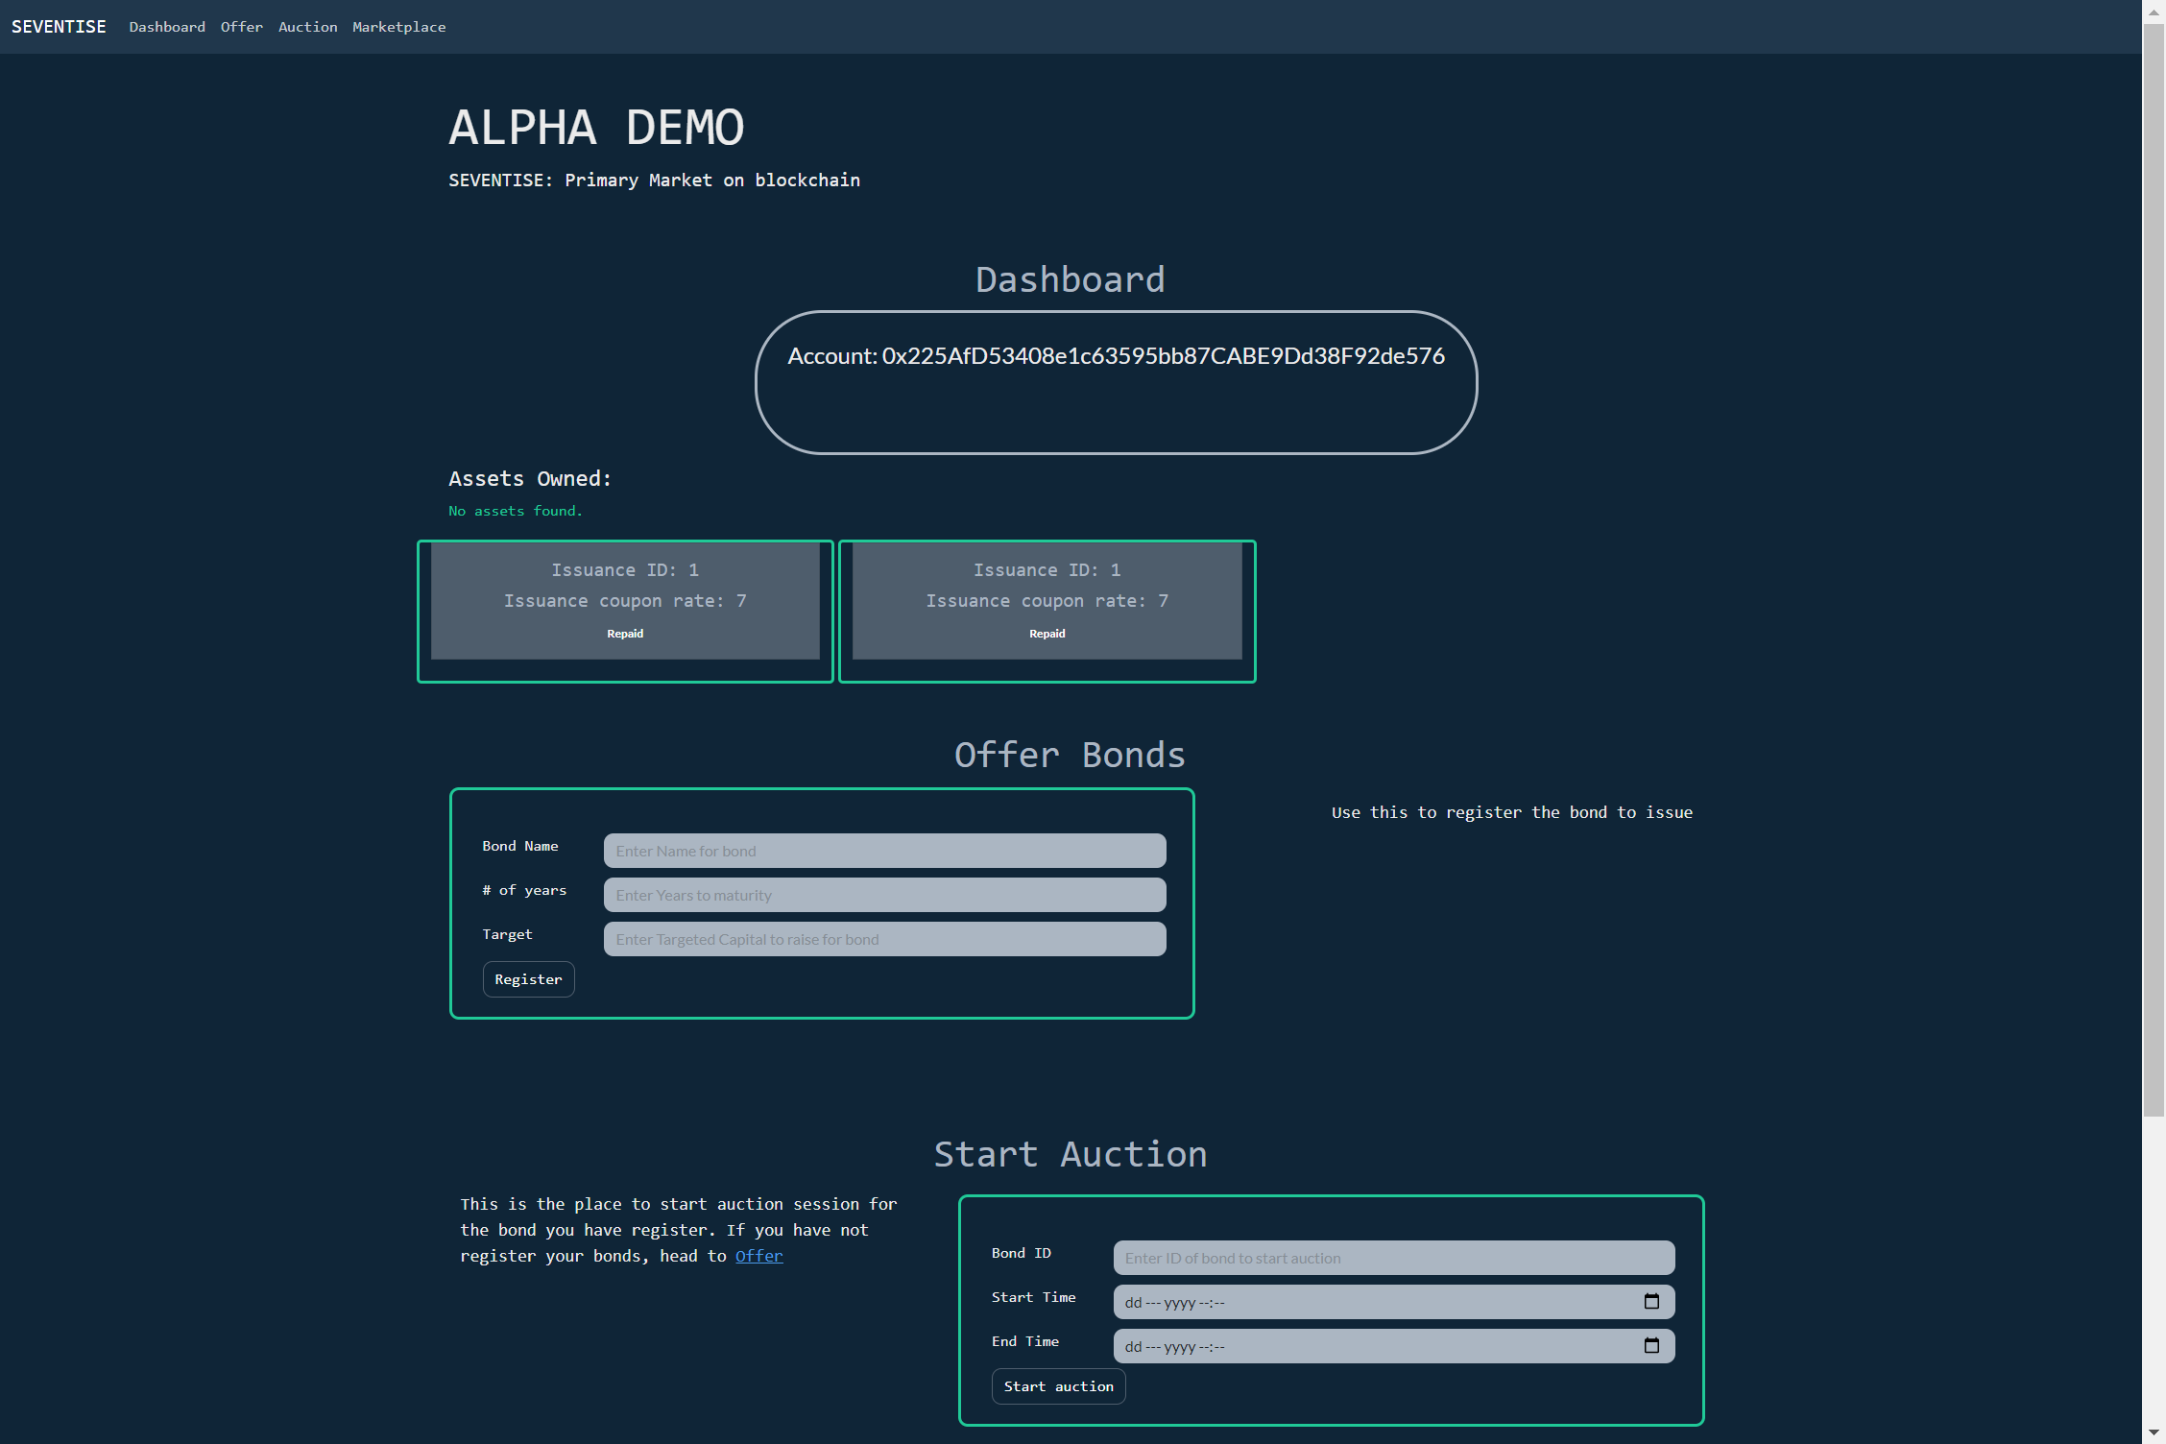
Current wallet address connected to the site
Issuance (Debt) status and details
Register bond for auction
Start auction here

Slide 3
Use Cases
1
Initial Debt Offering for Decentralised Applications
2
Commercial or Sovereign bond issuance on Primary Market
3
Raise capital for ideas from the community

Slide 4



Functionality
Integrating DeFi community and Capital seeker with robust governance
Share and communicate projects requiring capital directly with potential investors
Opportunities for commercial and sovereign bond offerings for the community

